Slide 1
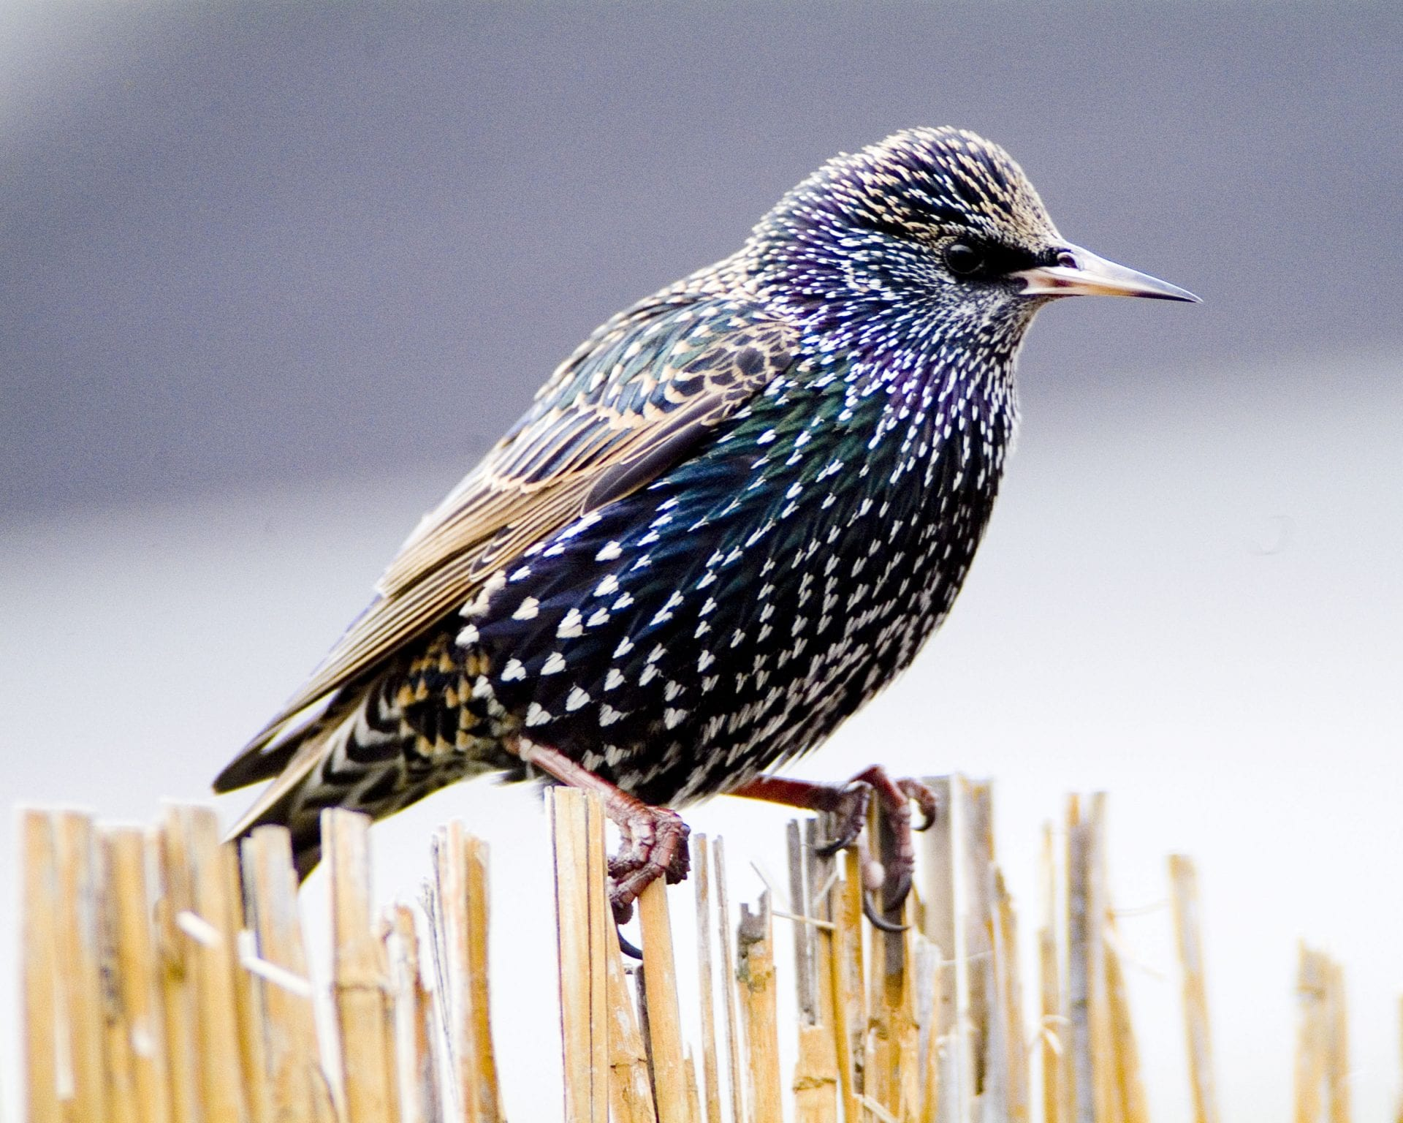

Slide 2
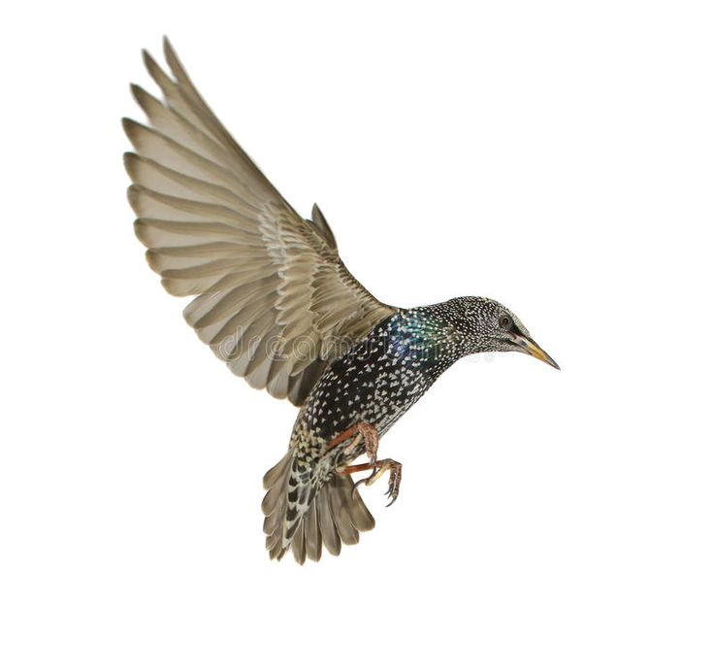
WEEK 3: SYSTEM THINKING THROUGH SPECULATIVE DESIGN (STSD)
COMP0184
January 2025
Notes:
in depth understanding of emerging user interfaces and technologies.

Slide 3
LOW VARIABLES # DISCRETE TIME SYSTEMS -MODELING-

Slide 4
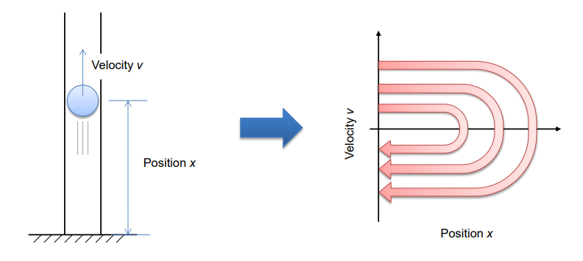
PHASE SPACE
A phase space of a dynamical system is a theoretical space where every state of the system is mapped to a unique spatial location.
Notes:
One of the benefits of drawing a phase space is that it allows you to visually represent the dynamically changing behavior of a system as a static trajectory in it. This provides a lot of intuitive, geometrical insight into the system’s dynamics, which would be hard to infer if you were just looking at algebraic equations.

Slide 5
STEP BACK
Time
Discrete
Continuous
Modeling
Analysis
DYNAMICAL SYSTEMS
Variables number
Small (1-3)
Large (4-many many)

Slide 6
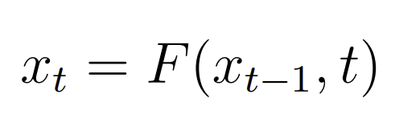
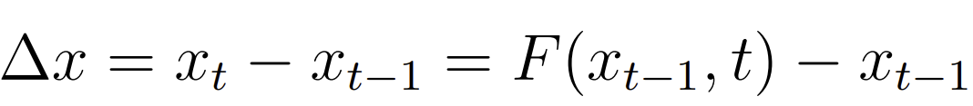
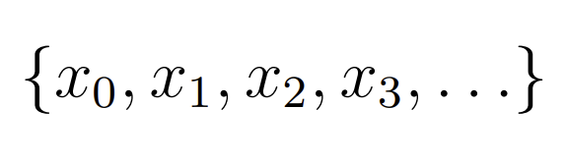
LOW VARIABLES #, DISCRETE TIME SYSTEMS -MODELING-

Slide 7
LOW VARIABLES #, DISCRETE TIME SYSTEMS -MODELING-
Three essential components of computer simulation
Initialize. You will need to set up the initial values for all the state variables of the system.
Observe. You will need to define how you are going to monitor the state of the system. This could be done by just printing out some variables, collecting measurements in a list structure, or visualizing the state of the system.
Update. You will need to define how you are going to update the values of those state variables in every time step. This part will be defined as a function, and it will be executed repeatedly

Slide 8

LOW VARIABLES #, DISCRETE TIME SYSTEMS -MODELING-

Slide 9
LOW VARIABLES #, DISCRETE TIME SYSTEMS -MODELING-
from pylab import *
a = 1.1
def initialize():
global x, result
x = 1.
result = [x]
def observe():
global x, result
result.append(x)
def update():
global x, result
x = a * x
initialize()
for t in xrange(30):
update()
observe()
plot(result)
show()

Slide 10
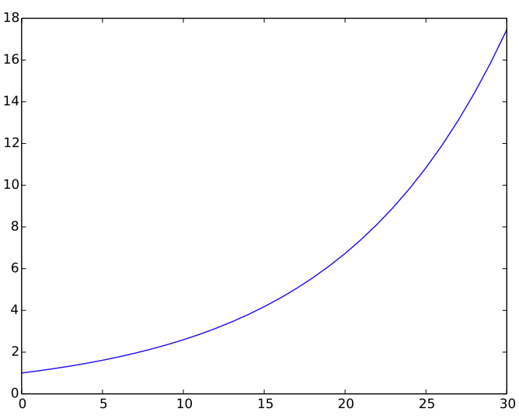
LOW VARIABLES #, DISCRETE TIME SYSTEMS -MODELING-
from pylab import *
a = 1.1
def initialize():
global x, result
x = 1.
result = [x]
def observe():
global x, result
result.append(x)
def update():
global x, result
x = a * x
initialize()
for t in xrange(30):
update()
observe()
plot(result)
show()

Slide 11
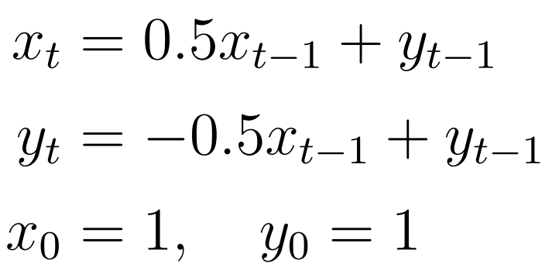
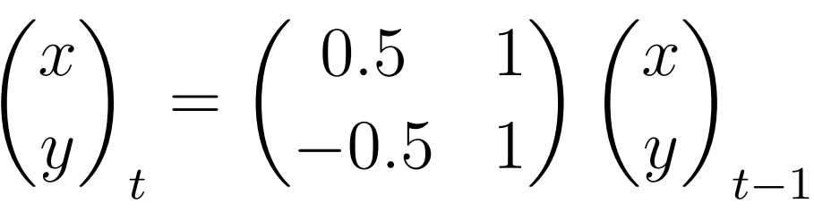
LOW VARIABLES #, DISCRETE TIME SYSTEMS -MODELING-

Slide 12
LOW VARIABLES #, DISCRETE TIME SYSTEMS -MODELING-
from pylab import *
def initialize():
global x, y, xresult, yresult
x = 1.
y = 1.
xresult = [x]
yresult = [y]
def observe():
global x, y, xresult, yresult
xresult.append(x)
yresult.append(y)
def update():
global x, y, xresult, yresult
x = 0.5 * x + y
y = -0.5 * x + y
initialize()
for t in xrange(30):
update()
observe()
plot(xresult, ’b-’)
plot(yresult, ’g--’)
show()

Slide 13
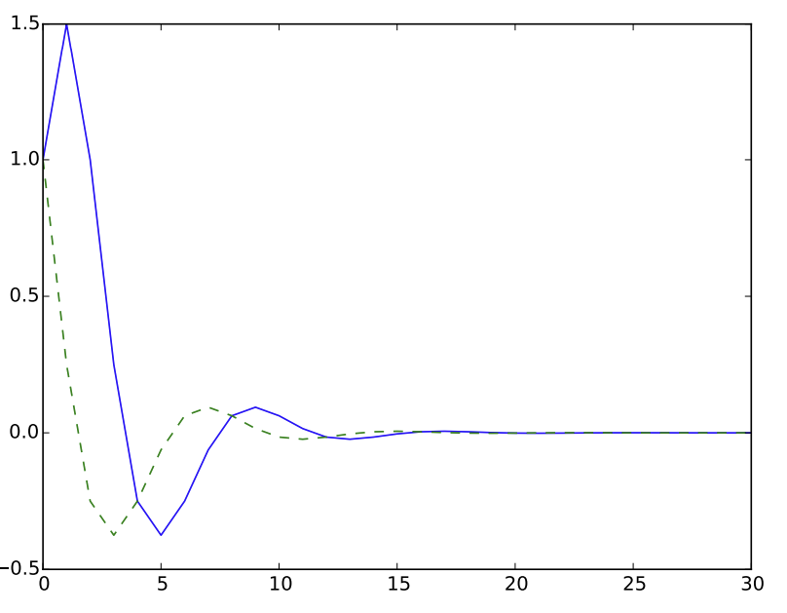
LOW VARIABLES #, DISCRETE TIME SYSTEMS -MODELING-
from pylab import *
def initialize():
global x, y, xresult, yresult
x = 1.
y = 1.
xresult = [x]
yresult = [y]
def observe():
global x, y, xresult, yresult
xresult.append(x)
yresult.append(y)
def update():
global x, y, xresult, yresult
x = 0.5 * x + y
y = -0.5 * x + y
initialize()
for t in xrange(30):
update()
observe()
plot(xresult, ’b-’)
plot(yresult, ’g--’)
show()

Slide 14
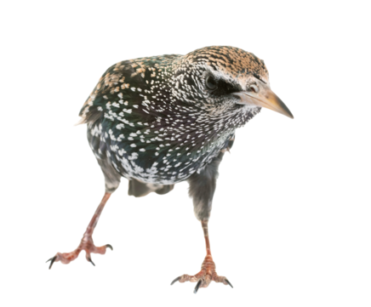
LOW VARIABLES #, DISCRETE TIME SYSTEMS -MODELING-
from pylab import *
def initialize():
global x, y, xresult, yresult
x = 1.
y = 1.
xresult = [x]
yresult = [y]
def observe():
global x, y, xresult, yresult
xresult.append(x)
yresult.append(y)
def update():
global x, y, xresult, yresult
x = 0.5 * x + y
y = -0.5 * x + y
initialize()
for t in xrange(30):
update()
observe()
plot(xresult, ’b-’)
plot(yresult, ’g--’)
show()

Slide 15
LOW VARIABLES #, DISCRETE TIME SYSTEMS -MODELING-
from pylab import *
def initialize():
global x, y, xresult, yresult
x = 1.
y = 1.
xresult = [x]
yresult = [y]
def observe():
global x, y, xresult, yresult
xresult.append(x)
yresult.append(y)
def update():
global x, y, xresult, yresult
nextx = 0.5 * x + y
nexty = -0.5 * x + y
x, y = nextx, nexty
initialize()
for t in xrange(30):
update()
observe()
plot(xresult, ’b-’)
plot(yresult, ’g--’)
show()

Slide 16
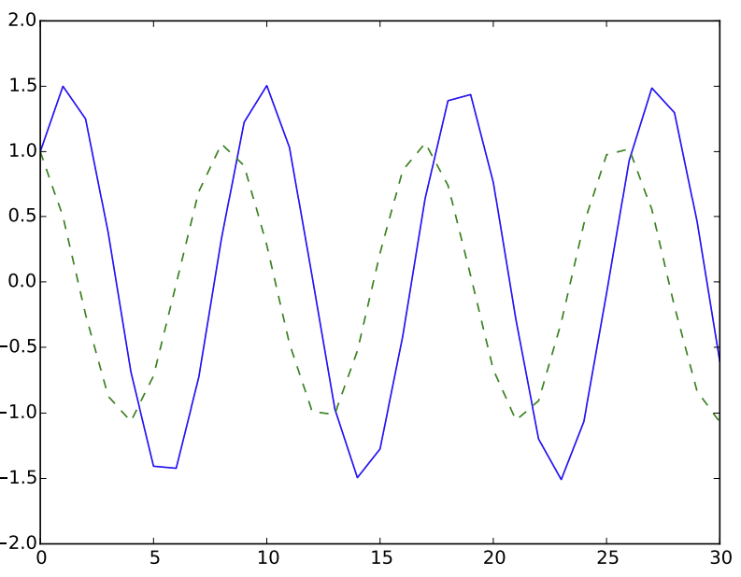
LOW VARIABLES #, DISCRETE TIME SYSTEMS -MODELING-
from pylab import *
def initialize():
global x, y, xresult, yresult
x = 1.
y = 1.
xresult = [x]
yresult = [y]
def observe():
global x, y, xresult, yresult
xresult.append(x)
yresult.append(y)
def update():
global x, y, xresult, yresult
nextx = 0.5 * x + y
nexty = -0.5 * x + y
x, y = nextx, nexty
initialize()
for t in xrange(30):
update()
observe()
plot(xresult, ’b-’)
plot(yresult, ’g--’)
show()

Slide 17
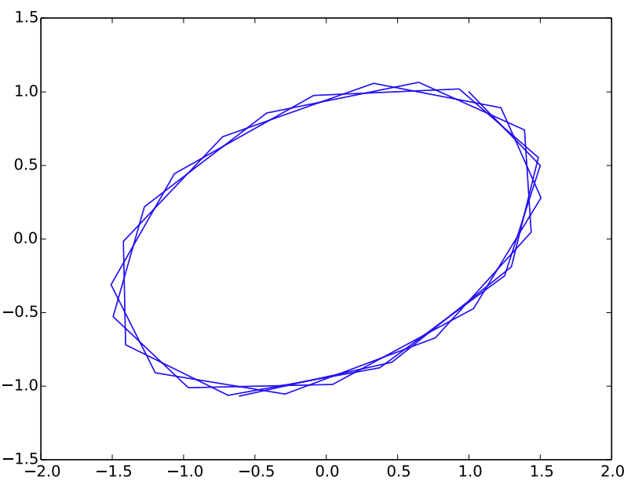
LOW VARIABLES #, DISCRETE TIME SYSTEMS -MODELING-
plot(xresult, yresult)

Slide 18
LOW VARIABLES #, DISCRETE TIME SYSTEMS -MODELING-
If you play around with the parameters you will notice that only a limited set of behaviors appear in the simulation
Possible behaviors include:
Exponential growth
Exponential decay
Smooth oscillations
Combinations (e.g. exponentially growing or decaying oscillations)
Because the system is LINEAR
Notes:
this equation is linear. Linearity means two things:
Additivity If $x_{1}\left(t\right)$and $x_{2}\left(t\right)$are solutions, then $x_{1}\left(t\right)+x_{2}\left(t\right)$is also a solution.
Homogeneity (scaling) If $x\left(t\right)$is a solution, then $c x\left(t\right)$is also a solution for any constant $c$.

Slide 19
LOW VARIABLES #, DISCRETE TIME SYSTEMS -MODELING-
If you aren’t sure where to start, just grab an existing model and tweak it.
Implement each model assumption one by one. Don’t try to reach the final model in one jump.
To implement a new assumption, first identify which part of the model equation represents the quantity you are about to change.
Whenever possible, adopt the simplest mathematical form.
Once your equation is complete, check if it behaves as you desired. It is often helpful to test its behavior with extreme values assigned to variables and/or parameters

Slide 20
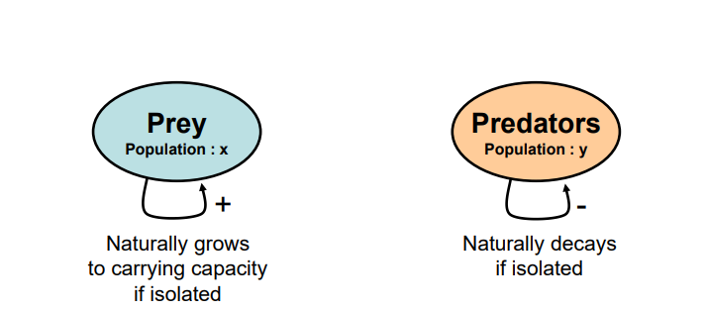
LOW VARIABLES #, DISCRETE TIME SYSTEMS -MODELING- EXAMPLE
PREDATOR-PREY SYSTEM
What variables are relevant?
Notes:
This type of diagram is called a causal loop diagram in System Dynamics. Each circle, or node, in this diagram represents a state variable in the system. The self-loop arrow attached to each node represents the effect of the variables on itself (e.g., the more prey there are, the faster their growth will be, etc.). The plus/minus signs next to the arrows show whether the effect is positive or negative

Slide 21
LOW VARIABLES #, DISCRETE TIME SYSTEMS -MODELING- EXAMPLE
PREDATOR-PREY SYSTEM
Prey grows if there are no predators
Predators die if there are no prey
How do variables behave?
Notes:
How do variables behave?

Slide 22
LOW VARIABLES #, DISCRETE TIME SYSTEMS -MODELING- EXAMPLE
PREDATOR-PREY SYSTEM
How do variables INTERACT?
Notes:
How do variables INTERACT?

Slide 23
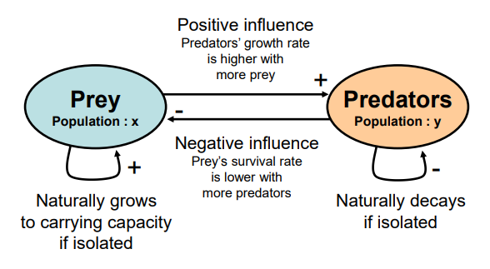
LOW VARIABLES #, DISCRETE TIME SYSTEMS -MODELING- EXAMPLE
PREDATOR-PREY SYSTEM
The prey’s death rate increases as the predator population increases
The predators’ growth rate increases as the prey population increases.
How do variables INTERACT?
Notes:
How do variables interact?

Slide 24


LOW VARIABLES #, DISCRETE TIME SYSTEMS -MODELING- EXAMPLE
PREDATOR-PREY SYSTEM
The prey’s death rate increases as the predator population increases
The predators’ growth rate increases as the prey population increases.
Prey grows if there are no predators
Predators die if there are no prey
Notes:
Here, we used the logistic growth model for the prey (x). This formula has two terms on its right hand side: the current population size (xt−1) and the number of newborns (rxt−1(· · ·)). If x is much smaller than K, the value inside the parentheses gets closer to 1. rx is the growth rate of the prey
We used the exponential decay model for the predators (y). dy is the death rate of the predators (0 < dy < 1).

Slide 25


LOW VARIABLES #, DISCRETE TIME SYSTEMS -MODELING- EXAMPLE
PREDATOR-PREY SYSTEM
The death rate of the prey should be 0 if there are no predators, while it should approach 1 (= 100% mortality rate!) if there are too many predators.
The growth rate of the predators should be 0 if there are no prey, while it can go up indefinitely as the prey population increases

Slide 26
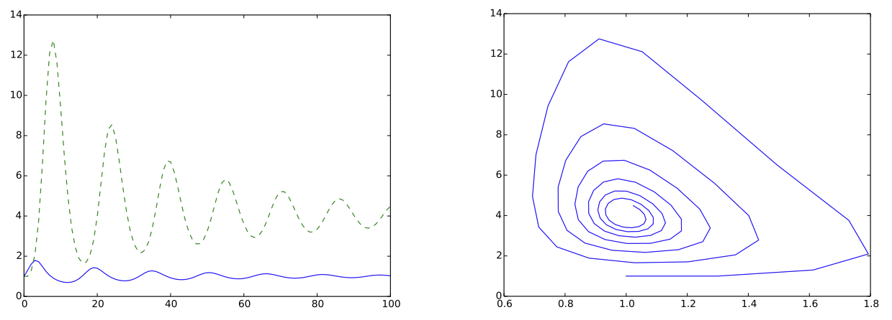
LOW VARIABLES #, DISCRETE TIME SYSTEMS -MODELING- EXAMPLE
PREDATOR-PREY SYSTEM

Slide 27
LOW VARIABLES # DISCRETE TIME SYSTEMS -ANALYSIS-

Slide 28
LOW VARIABLES #, DISCRETE TIME SYSTEMS -ANALYSIS -
EQUILIBRIA (EQUILIBRIUM POINTS)
Equilibrium points are important for both theoretical and practical reasons.
They are key points in the system’s phase space, which serve as meaningful references when we understand the structure of the phase space.
There are many situations where we want to sustain the system at a certain state that is desirable for us.
Is the desired stable or unstable.

Slide 29

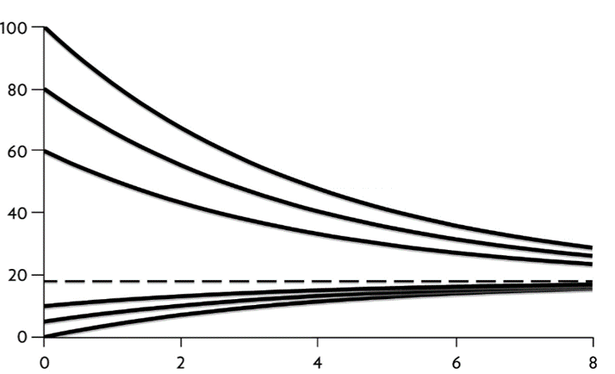




LOW VARIABLES #, DISCRETE TIME SYSTEMS -ANALYSIS -
EQUILIBRIA (EQUILIBRIUM POINTS)

Slide 30
LOW VARIABLES #, DISCRETE TIME SYSTEMS -ANALYSIS -
EQUILIBRIA (EQUILIBRIUM POINTS) AND PHASE SPACE
Discrete-time systems with continuous state variables can be visualized using computer simulations
Each initial condition X0​ produces one trajectory in the same phase space
A single trajectory shows only local behavior, not the global dynamics
Running simulations from many initial conditions reveals:
attractors and repellers
basins of attraction
large-scale structure of the phase space
This is implemented by sweeping initial values (and/or parameters) in simulation loops

Slide 31
LOW VARIABLES #, DISCRETE TIME SYSTEMS -ANALYSIS -
from pylab import *
def initialize():
global x, y, xresult, yresult
x = 1.
y = 1.
xresult = [x]
yresult = [y]
def observe():
global x, y, xresult, yresult
xresult.append(x)
yresult.append(y)
def update():
global x, y, xresult, yresult
nextx = 0.5 * x + y
nexty = -0.5 * x + y
x, y = nextx, nexty
initialize()
for t in xrange(30):
update()
observe()
plot(xresult, ’b-’)
plot(yresult, ’g--’)
show()
EQUILIBRIA (EQUILIBRIUM POINTS) AND PHASE SPACE

Slide 32
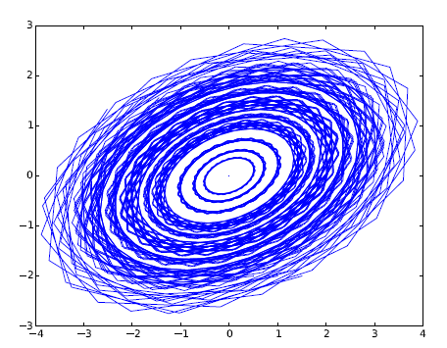
LOW VARIABLES #, DISCRETE TIME SYSTEMS -ANALYSIS -
EQUILIBRIA (EQUILIBRIUM POINTS) AND PHASE SPACE
for x0 in arange(-2, 2, .5): ###
for y0 in arange(-2, 2, .5): ###
initialize(x0, y0) ###
for t in xrange(30):
update()
observe()
plot(xresult, yresult, 'b') ###

Slide 33
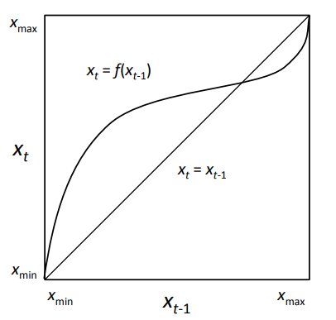
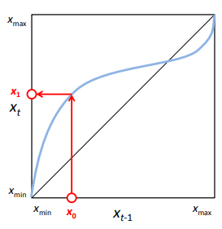
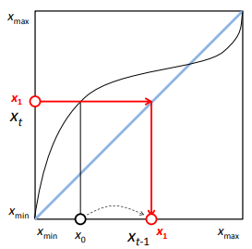
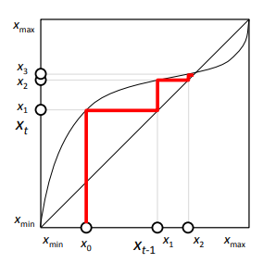
LOW VARIABLES #, DISCRETE TIME SYSTEMS -ANALYSIS -
COBWEB PLOTS
Notes:
Cobweb plots are a graphical method used to visualize the iterative process of dynamical systems, particularly those defined by discrete-time, one-dimensional recurrence relations. They help in understanding the behavior of sequences generated by such systems as they evolve over time. Cobweb plots are drawn by plotting the function defining the recurrence relation on the same graph as the line y=x, and then iterating the following steps from a given initial value:
From a point on the x-axis, draw a vertical line up to the function curve. (The curve is just the graph of the function you’re iterating.)
From this point on the curve, draw a horizontal line to the y=x line.
Repeat the process by drawing another vertical line from this new point back to the function curve, and so on.
This process creates a "cobweb" pattern of lines that visually demonstrates how the value of the variable evolves over successive iterations. Cobweb plots are particularly useful for analyzing the convergence or divergence of sequences, identifying fixed points (where the curve intersects the y=x line), and exploring the stability of these points. They provide a simple yet powerful tool for visualizing the dynamics of nonlinear systems in a two-dimensional space, making complex behaviors such as cycles and chaos more accessible and understandable.

Slide 34
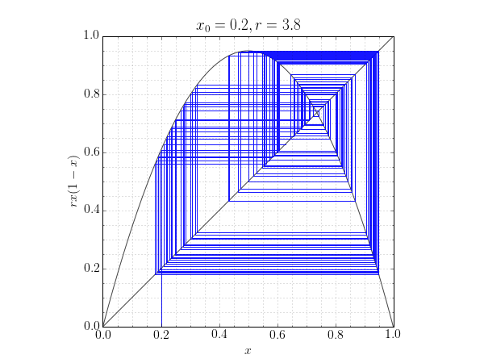
LOW VARIABLES #, DISCRETE TIME SYSTEMS -ANALYSIS -
import numpy as np
from matplotlib import rc
import matplotlib.pyplot as plt
# Use LaTeX throughout the figure for consistency
rc('font', **{'family': 'serif', 'serif': ['Computer Modern'], 'size': 16})
rc('text', usetex=True)
# Figure dpi
dpi = 72
def plot_cobweb(f, r, x0, nmax=40):
"""Make a cobweb plot.
Plot y = f(x; r) and y = x for 0 <= x <= 1, and illustrate the behaviour of
iterating x = f(x) starting at x = x0. r is a parameter to the function.
"""
x = np.linspace(0, 1, 500)
fig = plt.figure(figsize=(600/dpi, 450/dpi), dpi=dpi)
ax = fig.add_subplot(111)
# Plot y = f(x) and y = x
ax.plot(x, f(x, r), c='#444444', lw=2)
ax.plot(x, x, c='#444444', lw=2)
# Iterate x = f(x) for nmax steps, starting at (x0, 0).
px, py = np.empty((2,nmax+1,2))
px[0], py[0] = x0, 0
for n in range(1, nmax, 2):
px[n] = px[n-1]
py[n] = f(px[n-1], r)
px[n+1] = py[n]
py[n+1] = py[n]
# Plot the path traced out by the iteration.
ax.plot(px, py, c='b', alpha=0.7)
# Annotate and tidy the plot.
ax.minorticks_on()
ax.grid(which='minor', alpha=0.5)
ax.grid(which='major', alpha=0.5)
ax.set_aspect('equal')
ax.set_xlabel('$x$')
ax.set_ylabel(f.latex_label)
ax.set_title('$x_0 = {:.1}, r = {:.2}$'.format(x0, r))
plt.savefig('cobweb_{:.1}_{:.2}.png'.format(x0, r), dpi=dpi)
class AnnotatedFunction:
"""A small class representing a mathematical function.
This class is callable so it acts like a Python function, but it also
defines a string giving its latex representation.
"""
def __init__(self, func, latex_label):
self.func = func
self.latex_label = latex_label
def __call__(self, *args, **kwargs):
return self.func(*args, **kwargs)
# The logistic map, f(x) = rx(1-x).
func = AnnotatedFunction(lambda x,r: r*x*(1-x), r'$rx(1-x)$’)
plot_cobweb(func, 3.8, 0.2, 200)
COBWEB PLOTS
Notes:
The code below generates a cobweb plot for the logistic map: $f\left(x\right)=rx\left(1−x\right)$. With a chosen starting value of $x_{0}=0.5$, both stable and chaotic behaviour is observed for different values of $r$.

Slide 35
LOW VARIABLES #, DISCRETE TIME SYSTEMS -ANALYSIS -
ASIMPTOTIC BEHAVIOUR
One of the main objectives of rule-based modeling is to make predictions of the future. So, it is a natural question to ask where the system will eventually go in the (infinite) long run. This is called the asymptotic behavior of the system when time is taken to infinity, which turns out to be fully predictable if the system is linear.

Slide 36



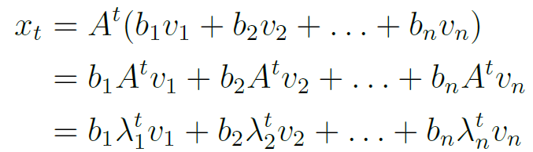

LOW VARIABLES #, DISCRETE TIME SYSTEMS -ANALYSIS -
ASIMPTOTIC BEHAVIOUR
Closed form solution
Simplify matrix using eigenvalues and eigenvectors
Notes:
throwing at a matrix one of its eigenvectors will “destroy the matrix” and turn it into a mere scalar number, which is the eigenvalue that corresponds to the eigenvector used
we need to represent the initial state x0 by using A’s eigenvectors as the basis vectors
Most real-world n × n matrices are diagonalizable and thus have n linearly independent eigenvectors, so here we assume that we can use them as the basis vectors to represent any initial state x0

Slide 37
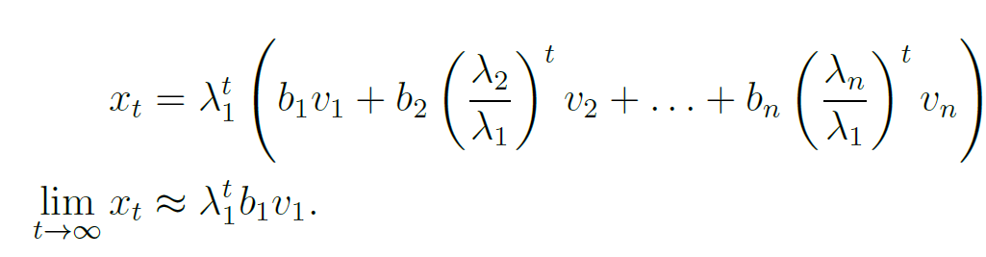
LOW VARIABLES #, DISCRETE TIME SYSTEMS -ANALYSIS -
ASIMPTOTIC BEHAVIOUR
This result clearly shows that the asymptotic behavior of xt is given by a summation of multiple exponential terms of λi
This eigenvalue with the largest absolute value is called a dominant eigenvalue, and its corresponding eigenvector is called a dominant eigenvector, which will dictate which direction (a.k.a. mode in physics) the system’s state will be going asymptotically

Slide 38
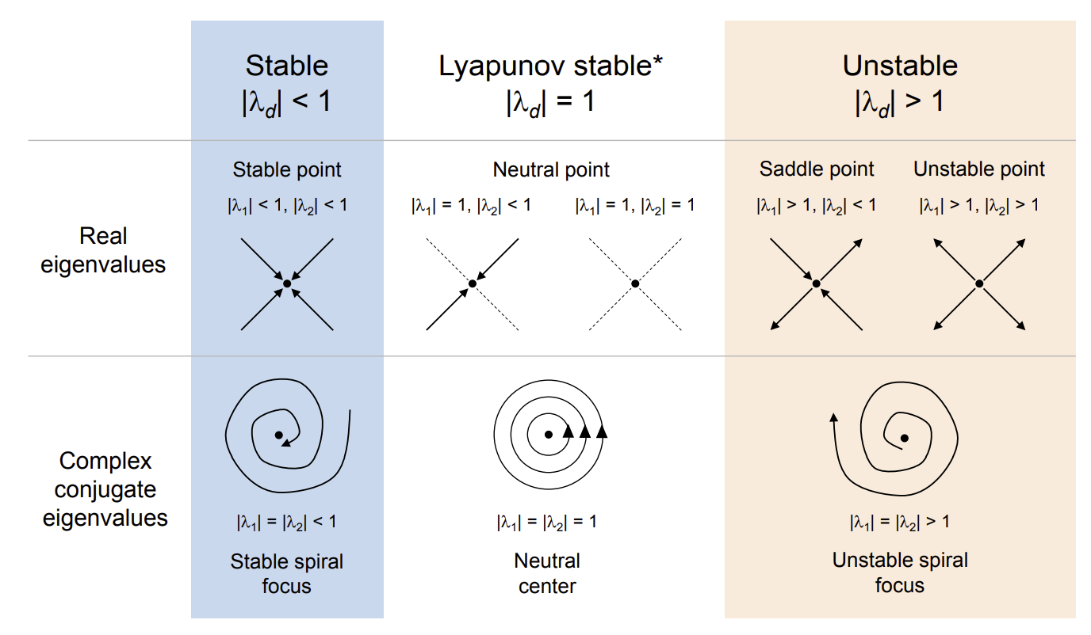
LOW VARIABLES #, DISCRETE TIME SYSTEMS –ANALYSIS -
Notes:
So eigenvectors are not arbitrary algebra objects — they are:
Directions in phase space that are invariant under the dynamics.

Slide 39
LOW VARIABLES #, DISCRETE TIME SYSTEMS -ANALYSIS -
ASIMPTOTIC BEHAVIOUR
This result clearly shows that the asymptotic behavior of xt is given by a summation of multiple exponential terms of λi
This eigenvalue with the largest absolute value is called a dominant eigenvalue, and its corresponding eigenvector is called a dominant eigenvector, which will dictate which direction (a.k.a. mode in physics) the system’s state will be going asymptotically

Slide 40




LOW VARIABLES #, DISCRETE TIME SYSTEMS -ANALYSIS -
ASIMPTOTIC BEHAVIOUR
This can be considered a very simple, trivial, linear version of self-organization. Let’s look at an example to better understand this concept. Consider the asymptotic behavior of the Fibonacci sequence:

Slide 41

LOW VARIABLES #, DISCRETE TIME SYSTEMS -ANALYSIS -
ASIMPTOTIC BEHAVIOUR
1.61803399
-0.61803399.

Slide 42
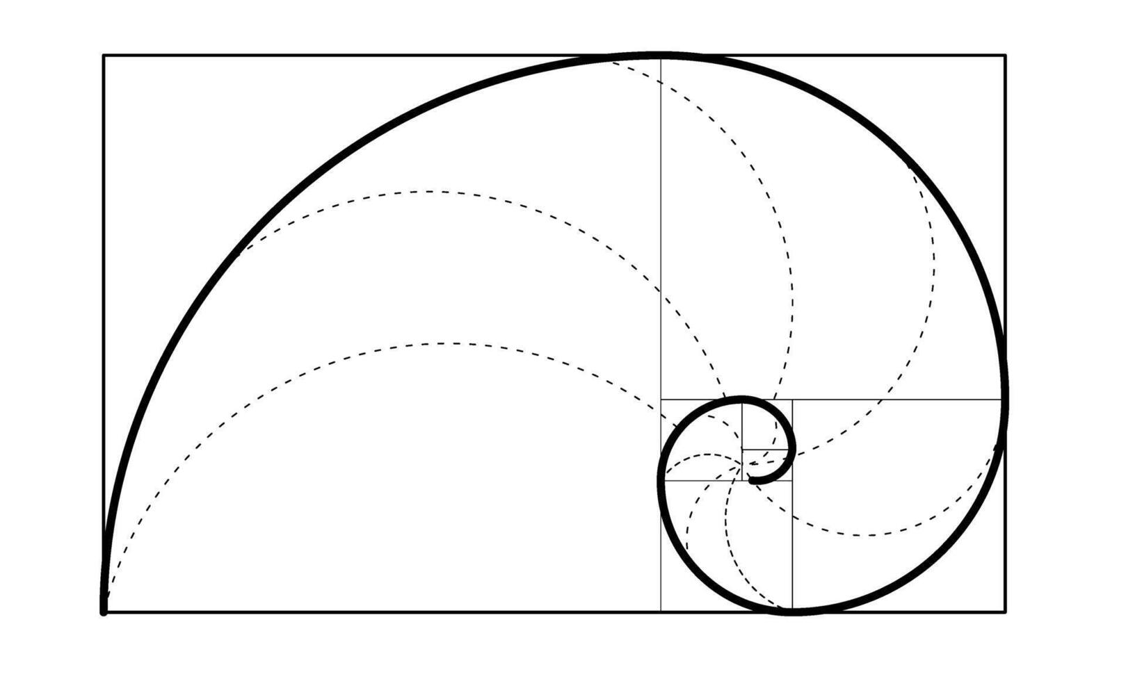
LOW VARIABLES #, DISCRETE TIME SYSTEMS -ANALYSIS -
ASIMPTOTIC BEHAVIOUR

Slide 43
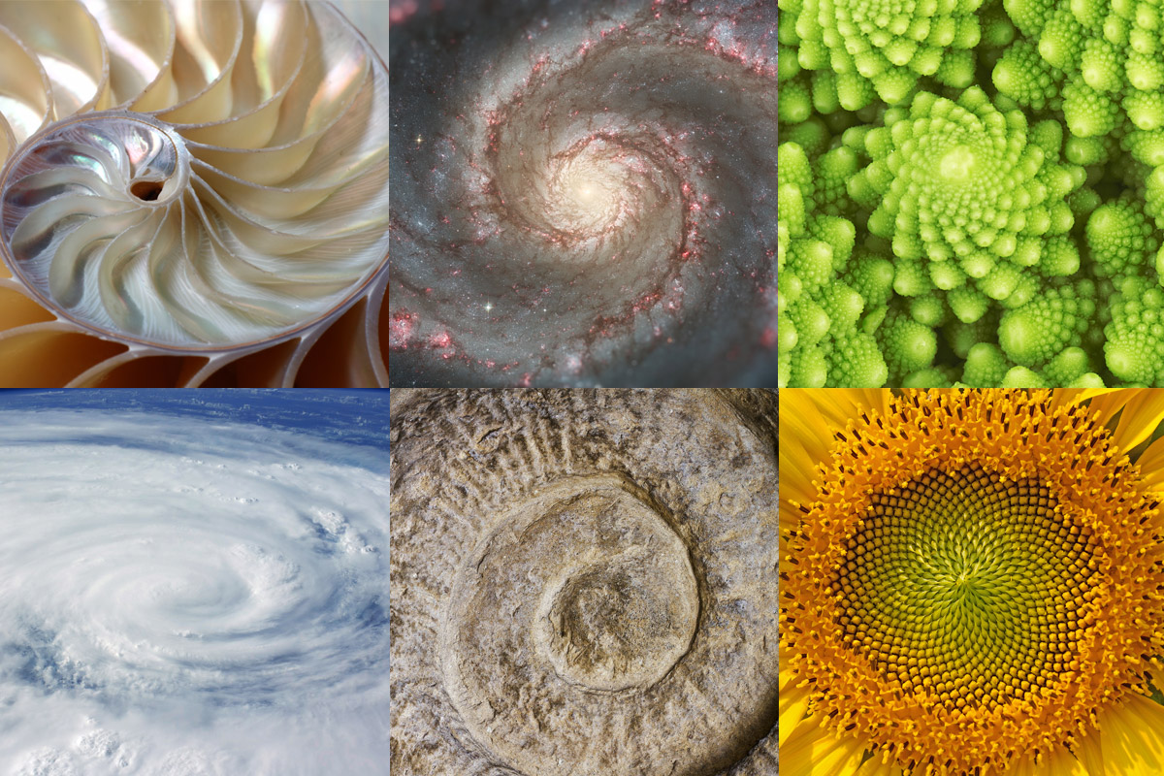

Slide 44
LOW VARIABLES #, DISCRETE TIME SYSTEMS -ANALYSIS -
ASIMPTOTIC BEHAVIOUR

Slide 45
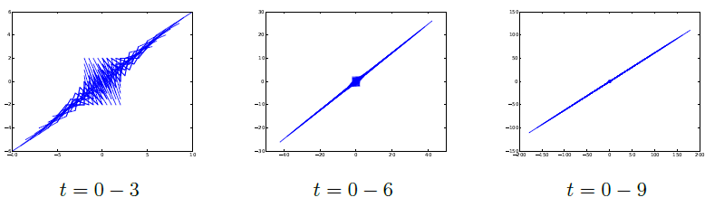
LOW VARIABLES #, DISCRETE TIME SYSTEMS -ANALYSIS -
ASIMPTOTIC BEHAVIOUR

Slide 46
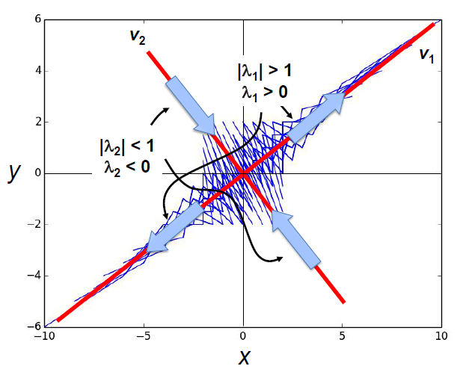
LOW VARIABLES #, DISCRETE TIME SYSTEMS -ANALYSIS -
ASIMPTOTIC BEHAVIOUR

Slide 47
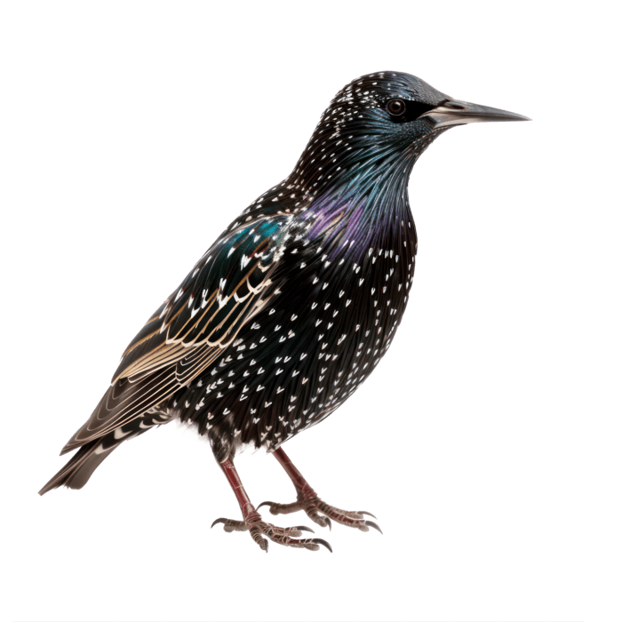
QUESTIONS?

Slide 48
COURSEWORK

Slide 49
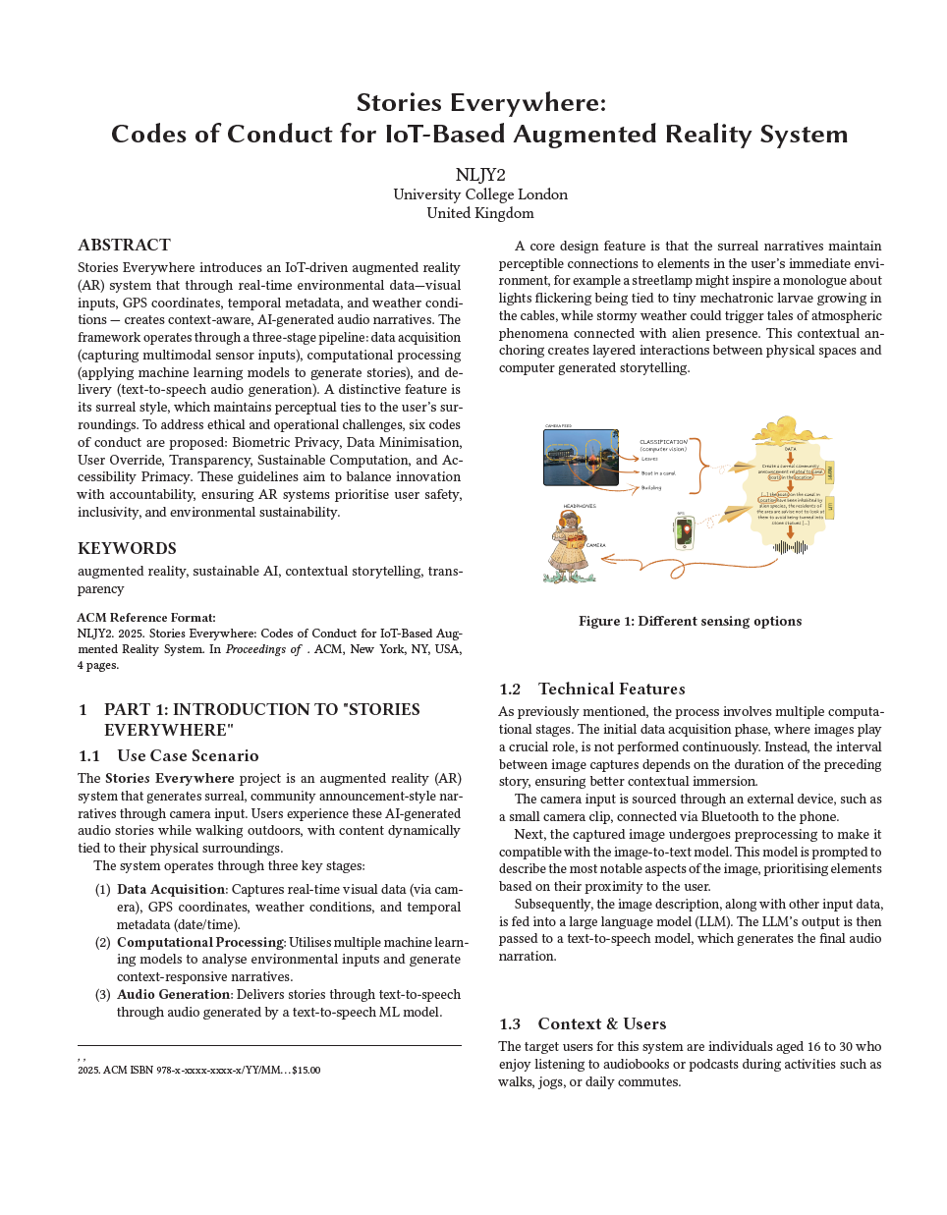

Slide 50
SYSTEM DESCRIPTION
Purpose: Establish context and technical grounding.
1 Use Case Scenario
Describes how users experience the AR system in real-world settings.
Introduces the three-stage pipeline:
Data acquisition
Computational processing
Audio generation
2 Technical Features
Explains implementation details (camera input, edge devices, ML models).
Clarifies how data flows through the system.
3 Context & Users
Defines the target audience and typical usage scenarios.

Slide 51
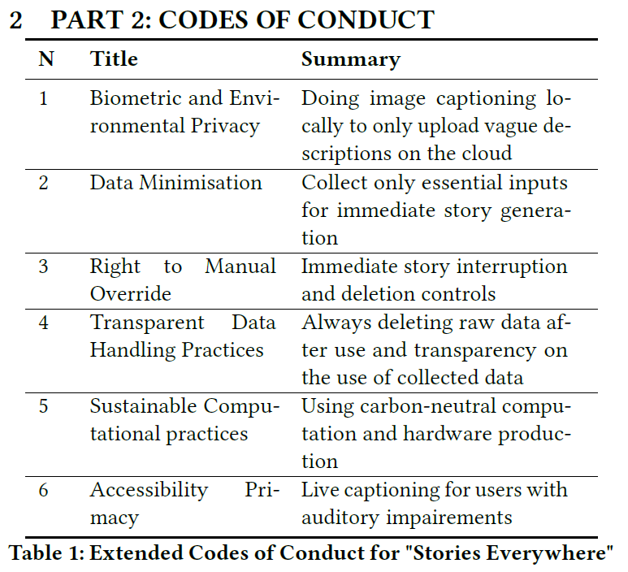
CODE OF CONDUCT
Purpose: Core theoretical and ethical considerations about the system.

Slide 52
SCENARIOS
Purpose: Evaluate the codes through speculative storytelling.
1. Introduces a fictional future (2075) as a design-fiction method.
2. Presents two contrasting scenarios:
Scenario 1: Codes are respected → positive, sustainable future
Scenario 2: Codes are ignored → surveillance, collapse, loss of trust
3. Each scenario is followed by a contextual explanation linking the fiction back to technical and societal implications.

Slide 53



Slide 54
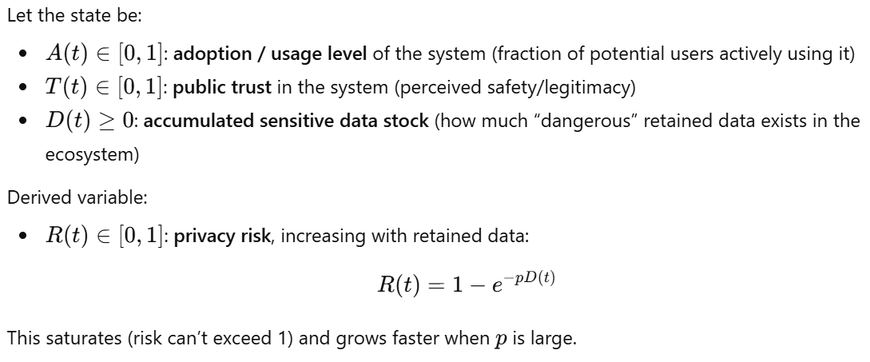

Slide 55
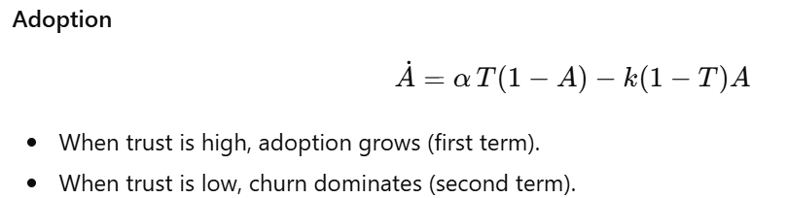
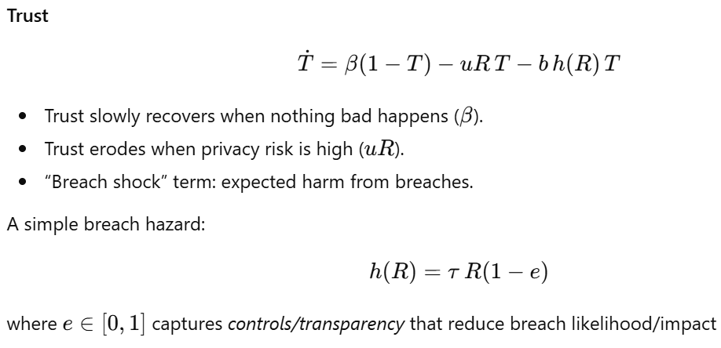

Slide 56
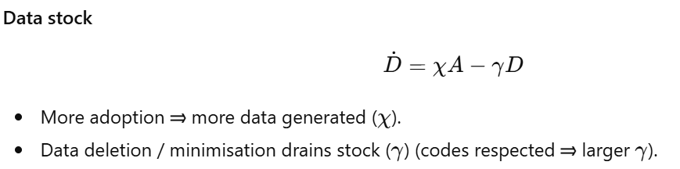

Slide 57
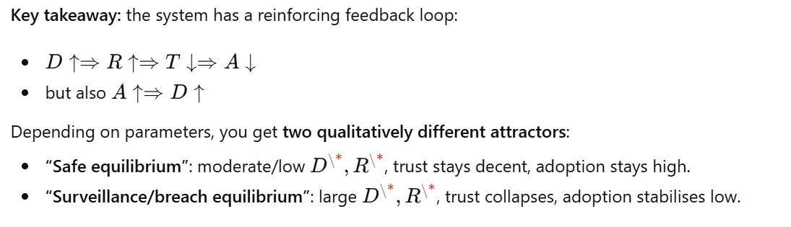

Slide 58
